Slide 1
Part B: agile principles
1: The enemy: Big Upfront Anything
2: Organizational principles
3: More organizational principles
4: Technical principles
5: A few method-specific principles

Slide 2
Understanding agile
Values
Principles
Managerial
Technical
Roles
Practices
Managerial
Technical
Artifacts

Slide 3
Agile principles
Organizational
1 Put the customer at the center
2 Accept change
3 Let the team self-organize
4 Maintain a sustainable pace
5 Produce minimal software:
5.1 Produce minimal functionality
5.2 Produce only the product requested
5.3 Develop only code and tests
Technical
6 Develop iteratively
6.1 Produce frequent working iterations
6.2 Freeze requirements during iterations
7 Treat tests as a key resource:
7.1 Do not start any new development until all tests pass
7.2 Test first
8 Express requirements through scenarios

Slide 4
Lifecycle models
Origin: Royce, 1970, Waterfall model
Scope: describe the set of processes involved in the production of software systems, and their sequencing
“Model” in two meanings of the term:
Idealized description of reality
Ideal to be followed

Slide 5
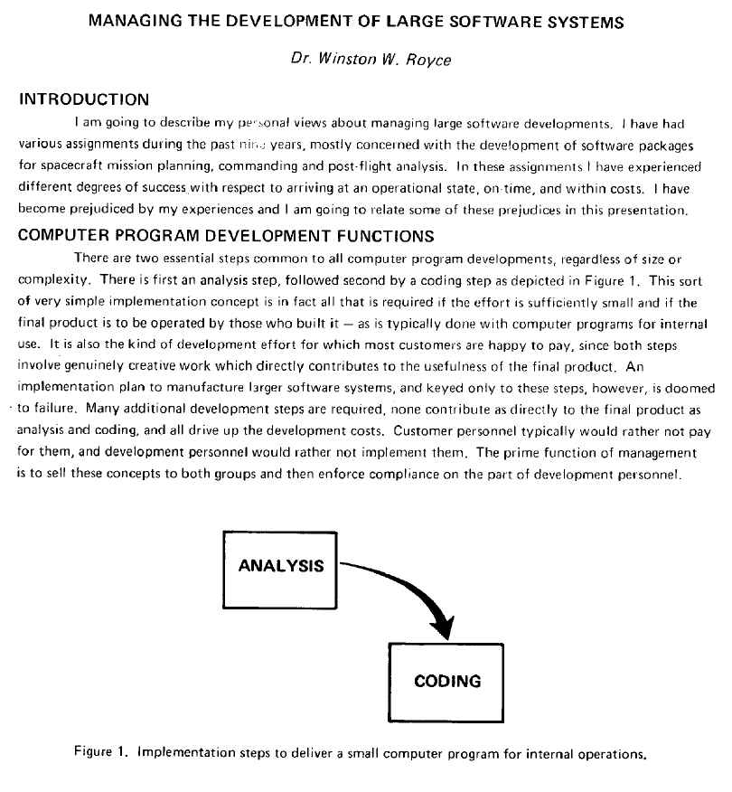
The original waterfall article
Source: Royce 1970
Proceedings of IEEE WESCON, pages 1-9, 1970

Slide 6
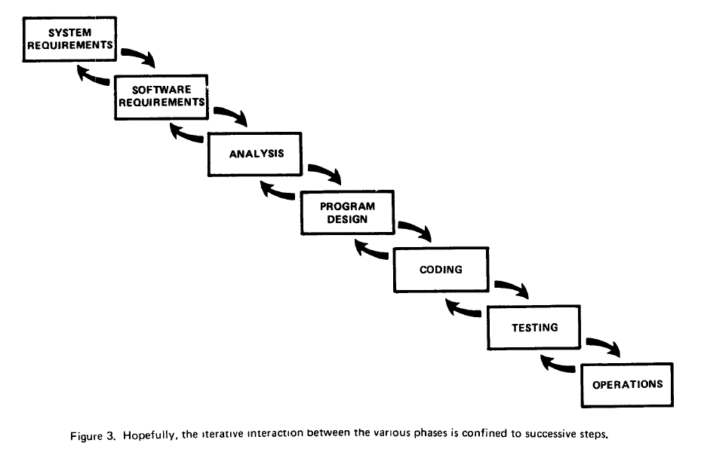
Waterfall (continued)
Source: Royce 1970
.

Slide 7
The waterfall model of the lifecycle
Feasibility study
Requirements
Specification
Global design
Detailed design
Implemen- tation
V & V
Distribution

Slide 8
Arguments for the waterfall
Source: Boehm 81
(After B.W. Boehm: Software engineering economics)
The activities are necessary
(But: merging of middle activities)
The order is the right one.

Slide 9
Problems with the waterfall
Late appearance of actual code
Lack of support for requirements change — and more generally for extendibility and reusability
Lack of support for the maintenance activity (70% of software costs?)
Division of labor hampering Total Quality Management
Impedance mismatches
Highly synchronous model

Slide 10
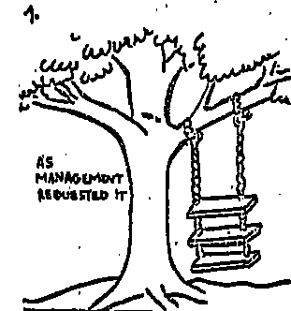
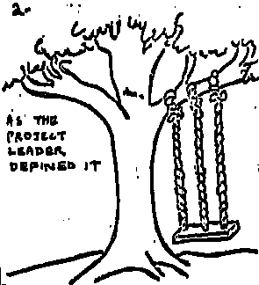
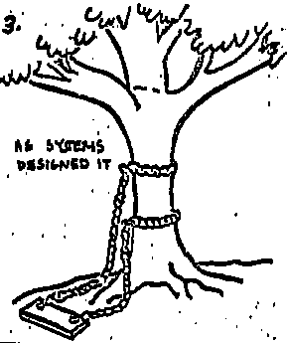
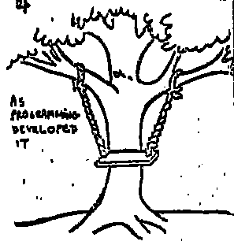
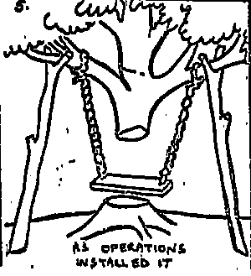
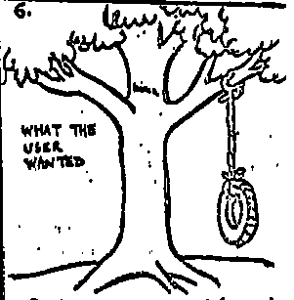
Impedance mismatches
As Management requested it.
As the Project Leader defined it.
As Systems designed it.
As Programming developed it.
As Operations installed it.
What the user wanted.
(Pre-1970 cartoon; origin unknown)

Slide 11
Requirements
80% of interface fault and 20% of implementation faults due to requirements (Perry & Stieg, 1993)
48% to 67% of safety-related faults in NASA software systems due to misunderstood hardware interface specifications, of which 2/3rds are due to requirements (Lutz, 1993)
85% of defects due to requirements, of which: incorrect assumptions 49%, omitted requirements 29%, inconsistent requirements 13% (Young, 2001).
Numerous software bugs due to poor requirements, e.g. Mars Climate Orbiter

Slide 12
The two agile criticisms of requirements
Change criticism
Waste criticism
Beck: Software development is full of the waste of overproduction, [such as] requirements documents that rapidly grow obsolete.

Slide 13
Agile views of requirements
Beck (XP):
Requirements gathering isn’t a phase that produces a static document, but an activity producing detail, just before it is needed, throughout development
Cohn (Scrum):
Scrum projects do not have an upfront analysis or design phase; all work occurs within the repeated cycle of sprints
Poppendieck (Lean):
And those things called requirements? They are really candidate solutions; separating requirements from implementation is just another form of handover

Slide 14
Part B: Principles 1: The Enemy: Big Upfront Anything
What we have seen: The waterfall model: a useful foil The role of requirements The risk of applying extreme precepts literally

Slide 15
Part B: agile principles
1: The enemy: Big Upfront Anything
2: Organizational principles
3: More organizational principles
4: Technical principles
5: A few method-specific principles

Slide 16
Agile principles
Organizational
1 Put the customer at the center
2 Accept change
3 Let the team self-organize
4 Maintain a sustainable pace
5 Produce minimal software:
5.1 Produce minimal functionality
5.2 Produce only the product requested
5.3 Develop only code and tests
Technical
6 Develop iteratively
6.1 Produce frequent working iterations
7.2 Freeze requirements during iterations
7 Treat tests as a key resource:
7.1 Do not start any new development until all tests pass
7.2 Test first
8 Express requirements through scenarios

Slide 17
1 Put the customer at the center
Beck: You will get [better] results with real customers. They are who you are trying to please. No customer at all, or a “proxy” for a real customer, leads to waste as you develop features that aren’t used, specify tests that don’t reflect the real acceptance criteria, and lose the chance to build real relationships between the people with the most diverse perspective of the project.
XP: embedded customer; Scrum: product owner
Can customer involvement replace requirements?

Slide 18
2 Accept change
Agile manifesto: “welcome” change
In standard software engineering, especially object-oriented: extendibility
Poppendieck: While in theory OO development produces code that is easy to change, in practice OO systems can be as difficult to change as any other, especially when information hiding is not deeply understood and effectively used

Slide 19
3 Let the team self-organize
XP
Lean
Scrum
Source: Poppendieck
Traditional view: managers tell workers to do their job
Agile view: managers listen to developers, explain possible actions, provide suggestions for improvements.
“The leader is there to:
Encourage progress
Help catch errors
Remove impediments
Provide support and help in difficult situations
Make sure that skepticism does not ruin the team’s spirit”
Team chooses own commitments & has access to customers

Slide 20
Self-organizing team: I Musici

Slide 21
Let the team self-organize
(Blog poster) The most important aspect of these methods is to put the management of the project squarely where it belongs: on the backs of the people doing the work. When the people actually doing the work have the final say in what gets done and when, then projects actually get done on time.
But (Schwaber): Control through peer pressure and “control by love” are the basis of subtle control. The dynamic flow of the team surfaces the tacit (unconscious) knowledge of the group and creates explicit knowledge in the form of software.

Slide 22


4 Maintain a sustainable pace

Slide 23
Maintaining a sustainable pace
XP
Scrum
Crystal
People perform best if they are not overstressed
Developers should not work more than 40 hour weeks,
If there is overtime or week-end work one week, there should not be any in the next week
XP avoids “crunch time” of traditional projects thanks to short release cycles
To help achieve these goals:
Frequent code-merge
Always maintain executable, test-covered, high-quality code
Constant refactoring, helping keep fresh and alert minds
Collaborative style
Constant testing

Slide 24
Part B: Principles 2: Organizational principles
What we have seen: Principles: Put the customer at the center Accept change Let the team self-organize Maintain a sustainable pace More to come…

Slide 25
Part B: agile principles
1: The enemy: Big Upfront Anything
2: Organizational principles
3: More organizational principles
4: Technical principles
5: A few method-specific principles

Slide 26
Agile principles
Organizational
1 Put the customer at the center
2 Accept change
3 Let the team self-organize
4 Maintain a sustainable pace
5 Produce minimal software:
5.1 Produce minimal functionality
5.2 Produce only the product requested
5.3 Develop only code and tests
Technical
6 Develop iteratively
6.1 Produce frequent working iterations
7.2 Freeze requirements during iterations
7 Treat tests as a key resource:
7.1 Do not start any new development until all tests pass
7.2 Test first
8 Express requirements through scenarios

Slide 27
5 Develop minimal software
Minimalism:
Minimal functionality
Product only
Only code and tests

Slide 28
5.1 Develop minimal software: functionality
YAGNI (Jeffries): [this principle] reminds us always to work on the story we have, not something we think we’re going to need. Even if we know we’re going to need it.
Poppendieck: Our software systems contain far more features than are ever going to be used. Extra features increase the complexity of the code, driving up costs nonlinearly. If even half of our code is unnecessary — a conservative estimate — the cost is not just double; it’s perhaps ten times more expensive than it needs to be.

Slide 29
The “lean” view
Source: Poppendieck
Seven wastes of software development:
Extra/Unused features (Overproduction)
Partially developed work not released (Inventory)
Intermediate/unused artifacts (Extra Processing)
Seeking Information (Motion)
Escaped defects not caught by tests/reviews (Defects)
Waiting (including Customer Waiting)
Handoffs (Transportation)

Slide 30
5.2 Develop minimal software: product only
Cunningham:
You are always taught to do as much as you can. Always put checks in. Always look for exceptions. Always handle the most general case. Always give the user the best advice. Always print a meaningful error message. Always this. Always that. You have so many things in the background that you’re supposed to do, there’s no room left to think. I say, forget all that and ask yourself, What’s the simplest thing that could possibly work?

Slide 31
About reuse…
Jeffries: Unless the projects are being done by the same team, reuse is quite difficult to do effectively: there is a big difference between some part of the project that I can reuse, and packaging that part well enough so that others can do so. I have to do packaging work that I wouldn’t do for myself, to document it, to make it more bulletproof, removing issues that I just work around automatically, to support it, answer questions about it, train people in how to use it. If I do those things, it’s expensive. If I don’t, using my stuff is difficult for others and doesn’t help them much.
I build the abstractions I need. If I need an abstraction again, in a different context, I would improve it. But unless my project’s purpose is to build stuff for other projects, I try not to waste any of my time and money building for other projects.

Slide 32
5.3 Develop minimal software: code & tests
Cockburn: You get no credit for any item that does not result in running, tested code. Okay, you also get credit for final deliverables such as training materials and delivery documentation.
Poppendieck: The documents, diagrams, and models produced as part of a software development project are often consumables, aids used to produce the system, but not necessarily a part of the final product. Once a working system is delivered, the user may care little about the intermediate consumables. Lean principles suggest that every consumable is a candidate for scrutiny. The burden is on the artifact to prove not only that it adds value to the final product, but also that it is the most efficient way of achieving that value.

Slide 33
Part B: Principles 1: The Enemy: Big Upfront Anything
What we have seen: Minimality in various guises: minimal functionality, product only, code and tests only

Slide 34
Part B: agile principles
1: The enemy: Big Upfront Anything
2: Organizational principles
3: More organizational principles
4: Technical principles
5: A few method-specific principles

Slide 35
Agile principles
Organizational
1 Put the customer at the center
2 Accept change
3 Let the team self-organize
4 Maintain a sustainable pace
5 Produce minimal software:
5.1 Produce minimal functionality
5.2 Produce only the product requested
5.3 Develop only code and tests
Technical
6 Develop iteratively
6.1 Produce frequent working iterations
7.2 Freeze requirements during iterations
7 Treat tests as a key resource:
7.1 Do not start any new development until all tests pass
7.2 Test first
8 Express requirements through scenarios

Slide 36
6 Develop iteratively
Iterativeness:
6.1 Frequent working iterations
6.2 Freeze requirements during iteration (Closed-Window Rule)

Slide 37
6.1 Iterativeness: frequent working iterations
Vertically-layered clusters
Horizontally-layered clusters

Slide 38
6.2 Iterativeness: freeze requirements during iteration
The Closed-Window Rule:
During an iteration, no one may add functionality
(or: the sprint is cancelled)
Scrum

Slide 39
Dual development
Early on: build infrastructure
Later: produce releases

Slide 40
7.1 Tests: do not move on until all tests pass
Excellent principle, to be reconciled with practical constraints
Need to classify severity

Slide 41
7.2 Test first
See discussion of practices

Slide 42
8 Express requirements through scenarios
User stories

Slide 43
User story
XP
Scrum
Source: Cohn
“A user story is simply something a user wants”
“Stories are more than just text written on an index card but for our purposes here, just think of user story as a bit of text saying something like
Paginate the monthly sales report
Change tax calculations on invoices.
Many teams have learned the benefits of writing user stories in the form of “As a … I … so that …”

Slide 44
Standard form for user stories
Scrum
“As a <user_or_role>
I want <business_functionality>
so that <business_justification>”
Example:
“As a customer, I want to see a list of my recent orders, so that I can track my purchases with a company.”

Slide 45
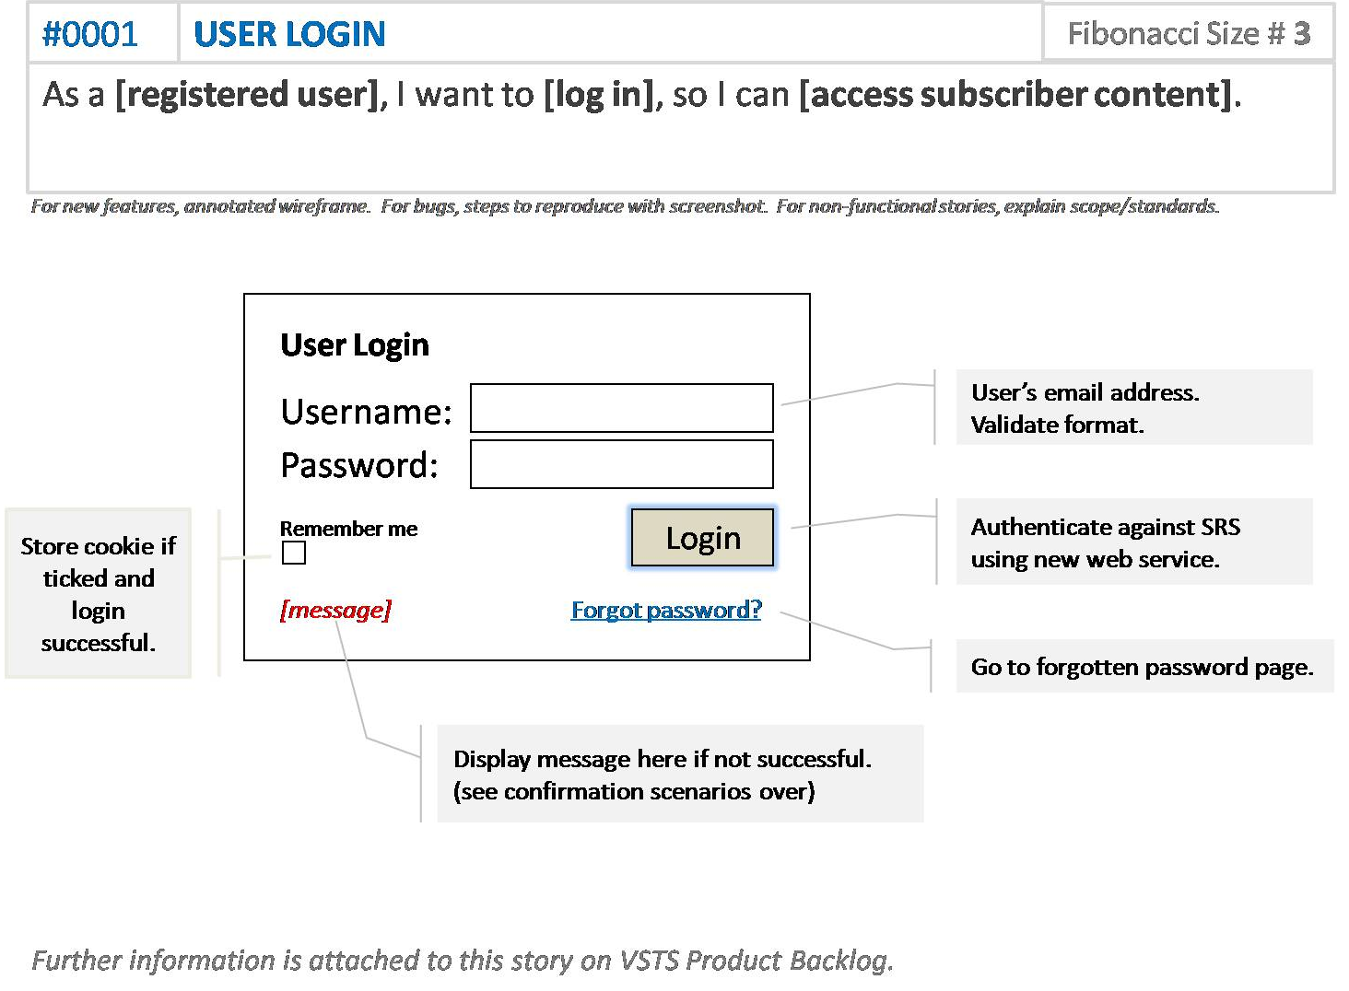
Example user story
Source: Waters
“I would certainly argue it is more easily digestible than a lengthy specification, especially for business colleagues”

Slide 46
User stories
X f (x)
0
0
1
1
2
4
3
9
4
16
...
...
See https://bertrandmeyer.com/2012/10/14/a-fundamental-duality-of-software-engineering/
or http://tinyurl.com/qzyxlal

Slide 47
Analysis
User stories help requirement elicitation but not a fundamental requirement technique. They cannot define the requirements:
Not abstract enough
Too specific
Describe current processes
Do not support evolution
User stories are to requirements what tests are to software specification and design
Major application: for validating requirements

Slide 48
Part B: Principles 5: Technical principles
What we have seen: Iterative development The fundamental role of tests (more to come) User stories as the source of requirements… … and the limits of this approach

Slide 49
Part B: agile principles
1: The enemy: Big Upfront Anything
2: Organizational principles
3: More organizational principles
4: Technical principles
5: A few method-specific principles

Slide 50
Agile principles
Organizational
1 Put the customer at the center
2 Accept change
3 Let the team self-organize
4 Maintain a sustainable pace
5 Produce minimal software:
5.1 Produce minimal functionality
5.2 Produce only the product requested
5.3 Develop only code and tests
Technical
6 Develop iteratively
6.1 Produce frequent working iterations
7.2 Freeze requirements during iterations
7 Treat tests as a key resource:
7.1 Do not start any new development until all tests pass
7.2 Test first
8 Express requirements through scenarios

Slide 51
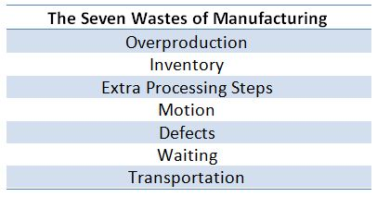
Eliminate waste
Lean
Source: Poppendieck
Everything not adding value to the customer is considered waste:
Unnecessary code
Unnecessary functionality
Delay in process
Unclear requirements
Insufficient testing
Avoidable process repetition
Bureaucracy
Slow internal communication
Partially done coding
Waiting for other activities, team, processes
Defects, lower quality
Managerial overhead
Value stream mapping: strategy to recognize waste. Eliminate it iteratively

Slide 52
Amplify learning
Lean
Source: Poppendieck
Software development is a continuous learning process
The best approach for improving a software development environment is to amplify and speed up learning:
To prevent accumulation of defects, run tests as soon as the code is written
Instead of adding documentation or planning, try different ideas by writing and testing code and building
Present screens to end-users and get their input
Enforce short iteration cycles, each including refactoring and integration testing
Set up feedback sessions with customers

Slide 53
Decide as late as possible
Lean
Source: Poppendieck
Delay decisions as much as possible until they can be made based on facts, not assumptions, and customers better understand their needs
The more complex a system, the more capacity for change should be built in
Use iterative approach to adapt to changes and correct mistakes, which might be very costly if discovered after system release
Planning remains, but concentrates on the different options and adapting to the current situation, as well as clarifying confusing situations by establishing patterns for rapid action

Slide 54
Focus
Crystal
Focus on individual task, to ensure progress:
Control flow of progress
Deal with interruptions:
Two-hour period without interruption
Assign developer to project for at least two days before switching
Focus on direction of project
Define goals clearly
Prioritize goals

Slide 55
Deliver as fast as possible
Lean
Scrum
Source: Poppendieck
It is not the biggest that survives, but the fastest
The sooner the end product is delivered, the sooner feedback can be received, and incorporated into the next iteration
For software, the Just-in-Time production ideology means presenting the needed result and letting the team organize itself to obtain it in a specific iteration

Slide 56
Multiple design
Lean
Source: Poppendieck
Another key idea from Toyota is set-based design. If a new brake system is needed, three teams may design solutions to the problem
If a solution is deemed unreasonable, it is cut
At period end, the surviving designs are compared and one chosen, perhaps with modifications based on learning from the others — an example of deferring commitment until the last possible moment
Software decisions could also benefit from this practice to minimize the risk brought on by big up-front design

Slide 57
Minimize dependencies
Scrum
Source: Sutherland
Scrum asserts that it is possible to remove dependencies between user stories, so that at any point any user story can be selected according to the proper criteria (maximizing business value)

Slide 58

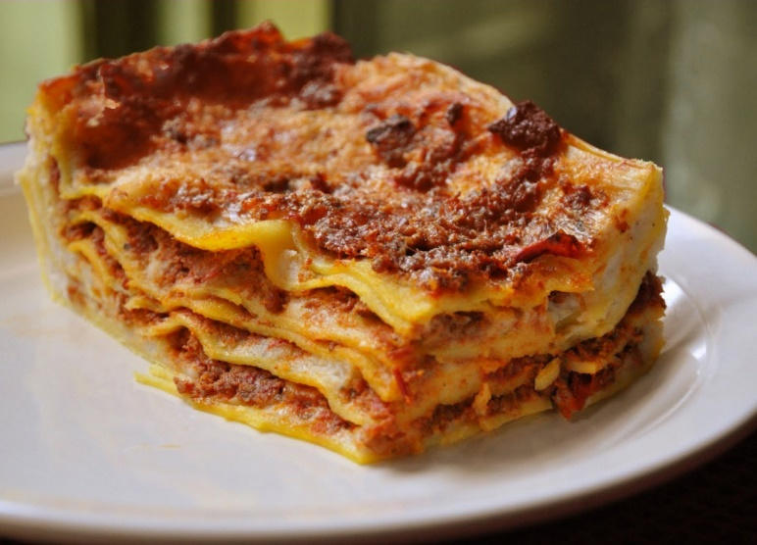
Additive and multiplicative complexity

Slide 59
Adding features
Source: Zave*
In telecommunication software, feature interactions are a notorious source of runaway complexity, bugs, cost and schedule overruns, and unfortunate user experiences.
Bob has “call-forwarding” enabled and is forwarding calls to Carol. Carol has “do-not-disturb”. Alice calls Bob, the call is forwarded to Carol, and Carol’s phone rings, because “do-not-disturb” is not applied to a forwarded call.
Alice calls a sales group. A feature for the sales group selects Bob as a sales representative on duty, and forwards the call to Bob. Bob’s cellphone is turned off, so his personal Voice Mail answers the call and offers to take a message.
[etc.]
*Abridged, see full citation in book

Slide 60
User stories (imagined)
(#1) As an executive, I want a redirection option so that if my phone is busy the call is redirected to my secretary
…
(#2) As a system configurator, I want to be able to specify various priorities for “busy” actions
..
(#3) As a salesperson, I want to make sure that if a prospect calls while I am in a conversation, the conversation is interrupted so that I can take the call immediately
…
(#4) As a considerate correspondent, I want to make sure that if a call comes while my phone is busy I get to the option of calling back as soon as the current call is over

Slide 61
Personal safety
Crystal
Encourage free expression of ideas
Do not ridicule anyone because of a question or suggestion
Build trust within the team

Slide 62
Humanity
XP
Source: Beck 05
Recognize that software is developed by people
Offer developers what they expect:
Safety
Accomplishment
Belonging
Growth
Intimacy
Agile approaches are indebted here to DeMarco’s and Lister’s Peopleware (see bibliography)

Slide 63
Part A: Context 6: A few method-specific principles
What we have seen: Important ideas from Scrum, Lean, Crystal and XP Minimize waste Accumulate user stories (and the limits of that approach) Amplify learning Ensure personal safety (and a few others)

